Slide 1

Prestigio Addreality Software

Slide 2

Sales strategy
There are 2 main sales strategies at Prestigio Solutions:
1. Sales to end customer (65% of working time should be dedicated to this channel)
Advantages:
We can influence client’s decision,
We can specify our specification in tender,
We can build relationships with client,
We can influence price, discount and margin.
Disadvantages:
Negotiations with client may be time-consuming,
It may be difficult to find a way to client, find the right decision-maker.
2. Through an intermediate party (integrator/partner) (35% of working time should be dedicated to this channel)
Advantages:
Time saving - an intermediate party communicates with client,
An intermediate party has client’s contacts,
Client’s needs are known, we may propose our solution already.
Disadvantages:
An intermediate party may choose another solution provider,
We can not influence clients (create wants, handle objections),
Usually it is a low-margin deal.
*If the tender already exist & announced – means some one already wrote requirements there.
*You have 0.1% chance to win the tender which not belong to you, don’t spend more than 1% of your time for it.

Slide 3
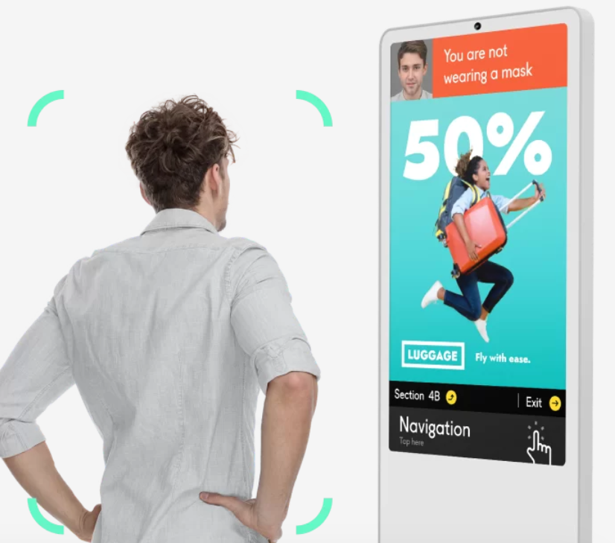
Prestigio Addreality Introduction
Prestigio Addreality - online platform for offline digital advertising
Digital signage with real-time analytics, customer flow, mood recognition and instore performance
One Platform for content management on any touchpoints
Connect all the digital surfaces, tablets, displays and background music to cross-platform centralized content management and audience analytics system.

Slide 4
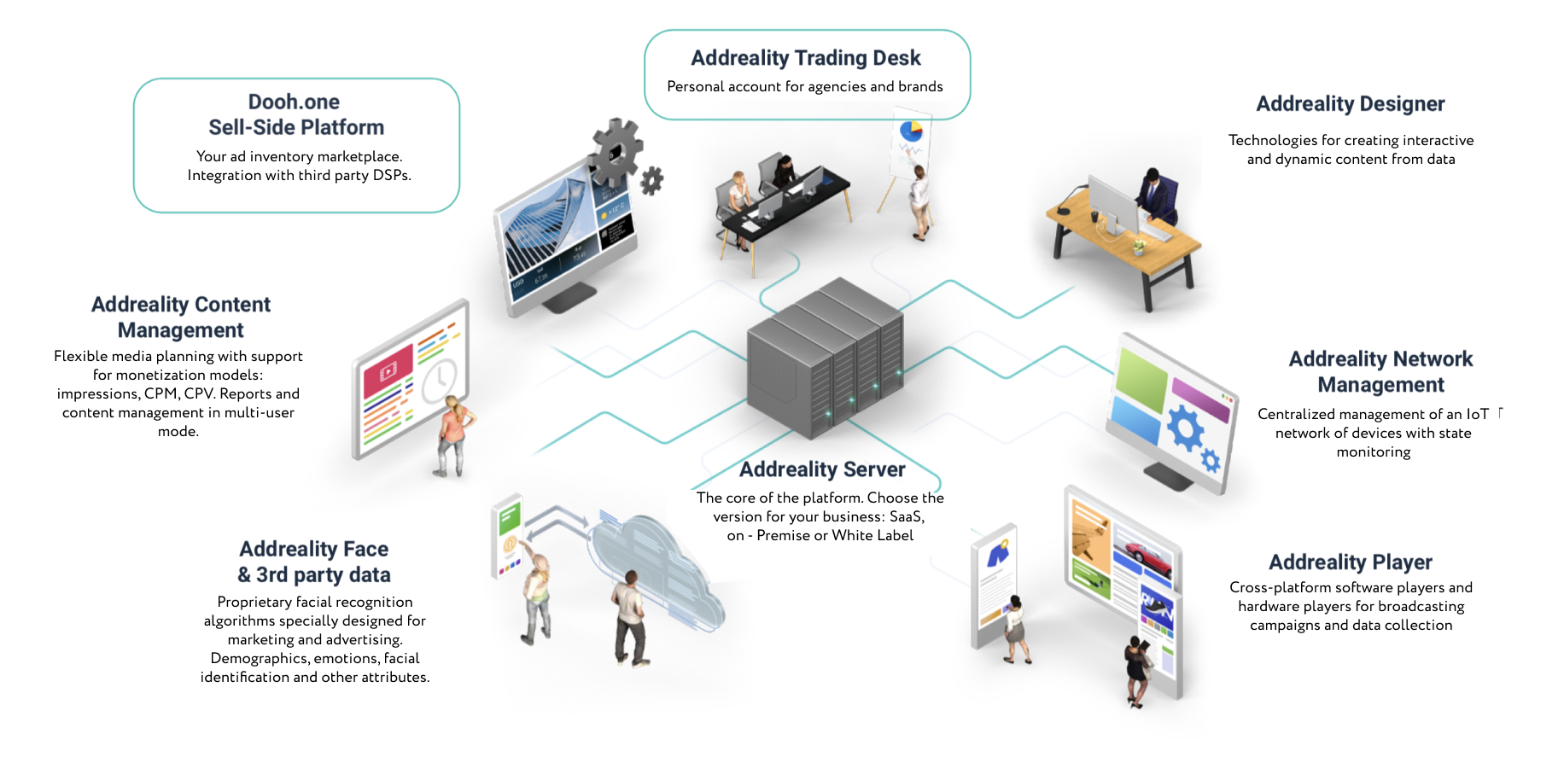
Solution infrastructure
Prestigio Addreality Trading Desk
Prestigio Addreality Designer
Prestigio Addreality Content Management
Prestigio Addreality Network Management
Prestigio Addreality Server
Prestigio Addreality Face & 3rd party data
Prestigio Addreality Player

Slide 5
Licenses type
CLOUD BASE type of infrastructure:
1 license for each player
There are 4 types of licenses in the portfolio:
Signage
Interactive
Sound
Face Pro (for a face and emotion recognition)
Prestigio-Addreality Designer* for 1 installation (for a unique project creation)
Cloud base
On premise
TYPE OF LICENSES
ON PREMISE type of infrastructure:
1 license for on premise server
1 license for each player
Installation of the server software
Integration with internal systems of the customer (if needed)
To create own advertising campaigns from the scratch you need to buy Prestigio Addreality Designer application
On-premise licenses cost differ from cloud based and discussed for each project.

Slide 6
Prestigio-Addreality subscriptions overview
TITLE | SOUND | SIGNAGE | INTERACTIVE
Description | Player for background music and audio advertising | Player for Digital Signage | Player for touch kiosks, tablets and tables
Full screen project templates |  | ü | ü
Multilayer project templates |  | ü | ü
Interactive project templates |  |  | ü
Prestigio-Addreality Designer templates |  | up to UltraHD | up to UltraHD
Device screenshot request |  | ü | ü
Device schedule settings | ü | ü | ü
Broadcasting points` response time | up to 30 – 60 seconds | up to 2 – 7 seconds | up to 2 – 7 seconds
Device command sending (immediate and scheduled commands) | ü | ü | ü
Expanded set of device management commands (including OS commands) | ü | ü | ü
Expanded logs sending | ü | ü | ü
Real-time device status update | ü | ü | ü
Real-time schedule update | ü | ü | ü
Using of third-party applications in project, for example: Apk (Android), AIR, SWF (Flash) |  | ü | ü
Content playback statistics | ü | ü | ü
Traffic costs savings due to P2P (Peer- to-Peer) networks technology | ü | ü | ü
P2P commands and data transfer | ü | ü | ü
P2P video synchronization
«Sound Panel» for professional background sound and audio advertising broadcasting | ü | ü | ü
Video resolution |  | 1080р and higher | 1080р and higher
Flexible traffic using settings due to «Traffic Shaper» technology (content upload time and speed scheduling) | ü | ü | ü
Extended desktop mode
Kiosk mode - unauthorized program exit blocking |  |  | ü
Screenshot request from server | ü | ü | ü
Prestigio-Addreality expanded module licenses
TITLE | DESCRIPTION | SUPPORT
Designer project editor | Templates and interactive projects editor. 100% automatization of production and video broadcasting process due to powerful project editor. Enables to create interactive projects for touch surfaces without code writing. From traditional service quality evaluation to catalogs and complex feedback forms. | Windows 7 or higher Mac OS X 10.9 or higher
Audience (Face Pro) | AUDIENCE and -15+ facial attributes detection and targeting -Unique views - Unique conversion rate - Customer journey - Win- and Android based | Supporting of built-in/USB cameras. PC running Windows 7, 8.1, 10. Processors with AVX instructions support.

Slide 7
Who needs the solution?

Slide 8
Prestigio-Addreality
Starting deals
Key markets for Prestigio Addreality Software:
Food retail
Pharma
DIY
Fashion
IT retail
Horeca
Office buildings
Key decision makers for Prestigio Addreality deals:
Director of point of sales development
Director for innovations
Commercial Director
Marketing Director
IT department at the step of tech evaluation (could be a blocker during start of project sales)
Key drivers of the project could be:
Product group manager
Business development manager
Key blockers:
Purchase department
IT department could be opposition at start stage

Slide 9
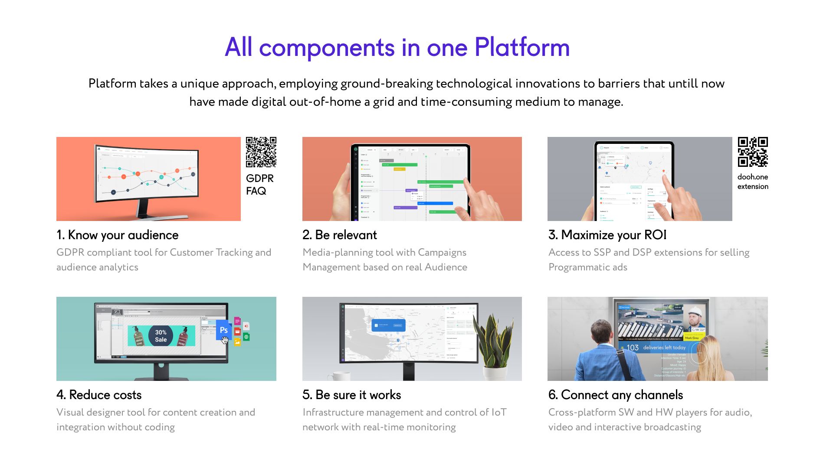
General benefits

Slide 10
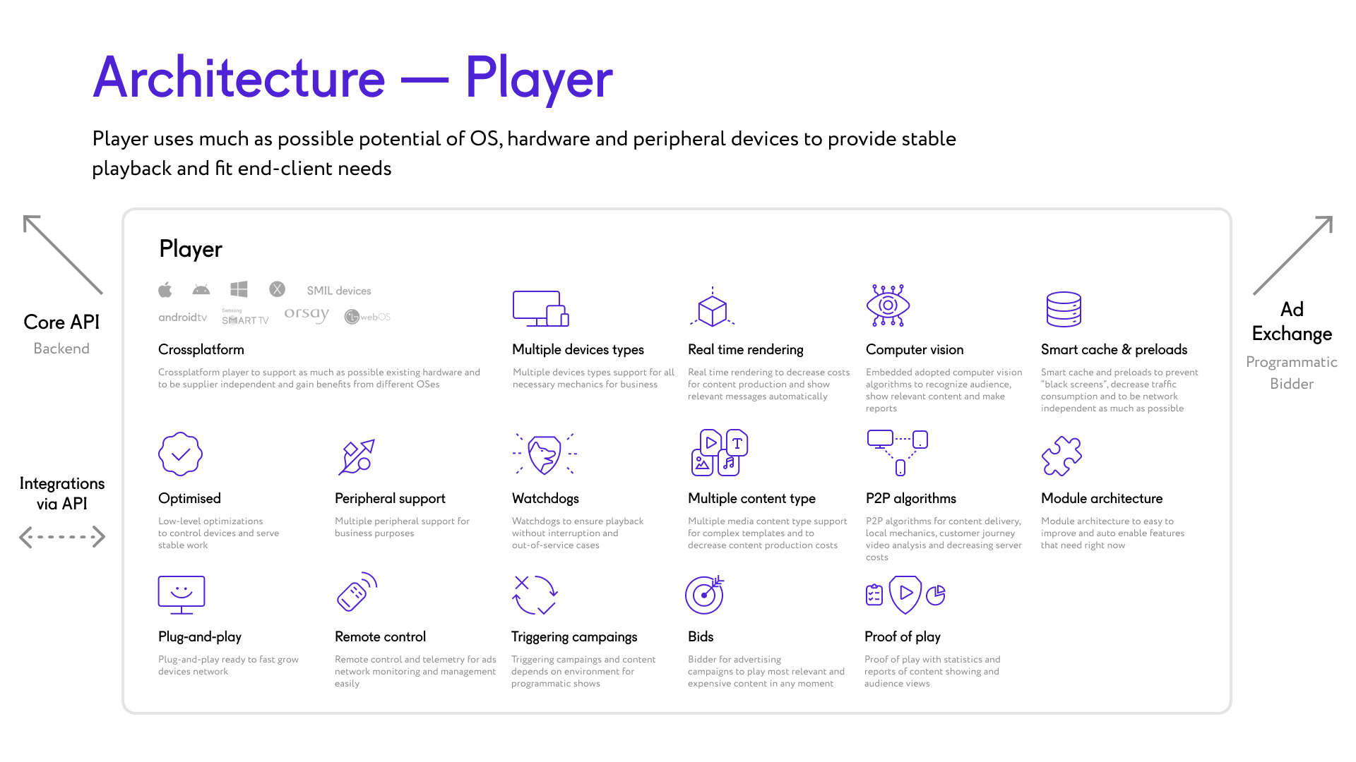
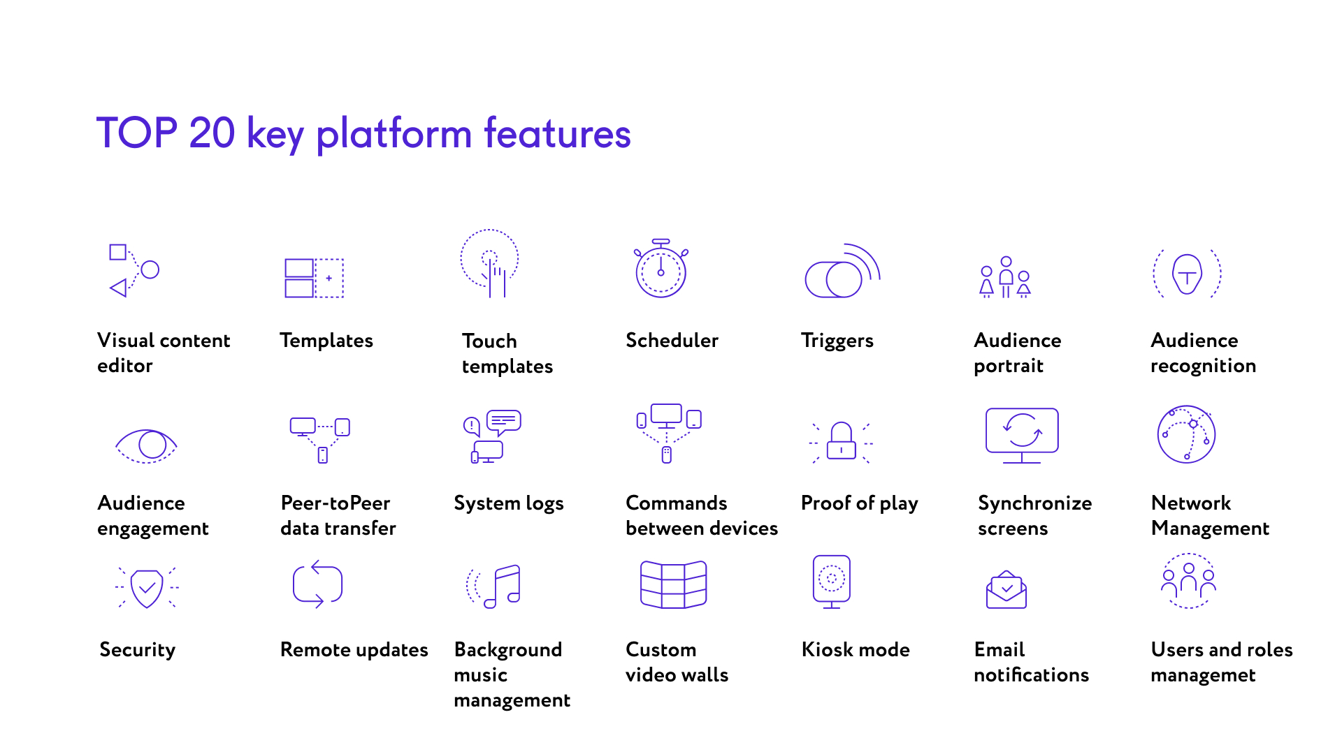
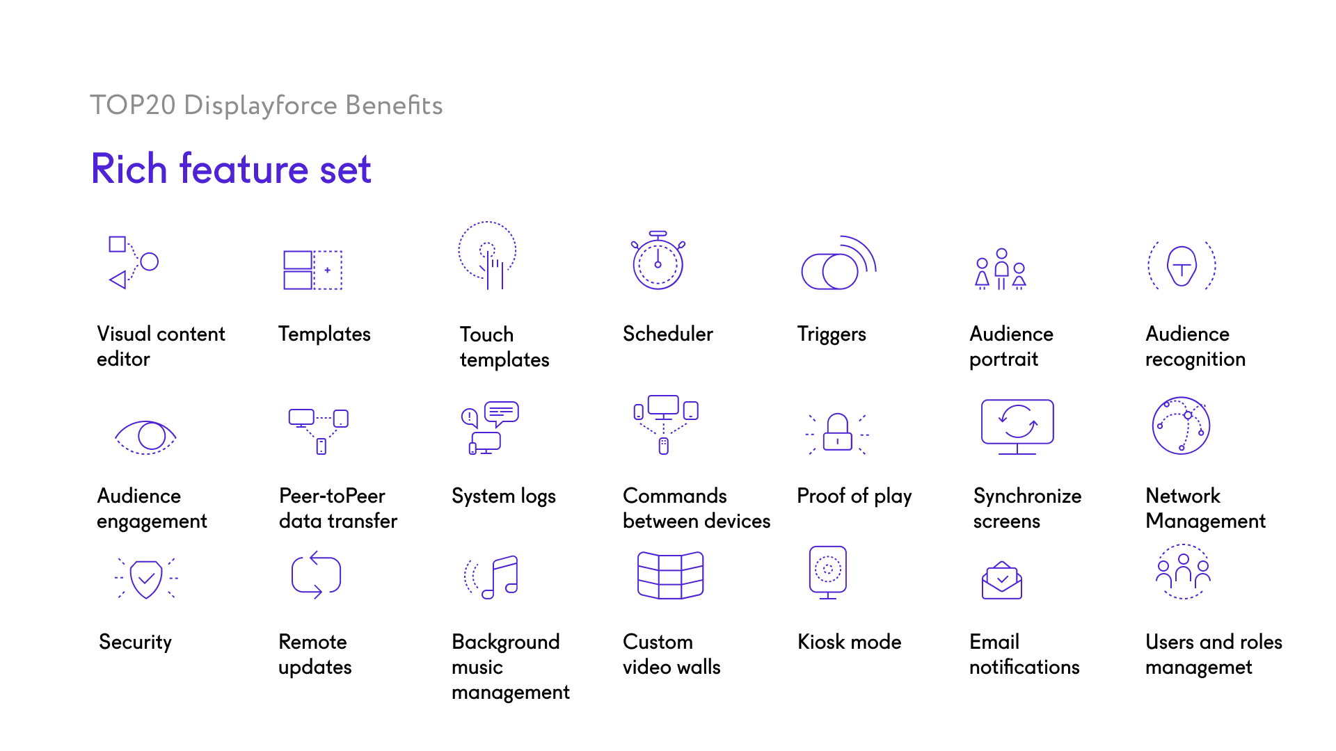
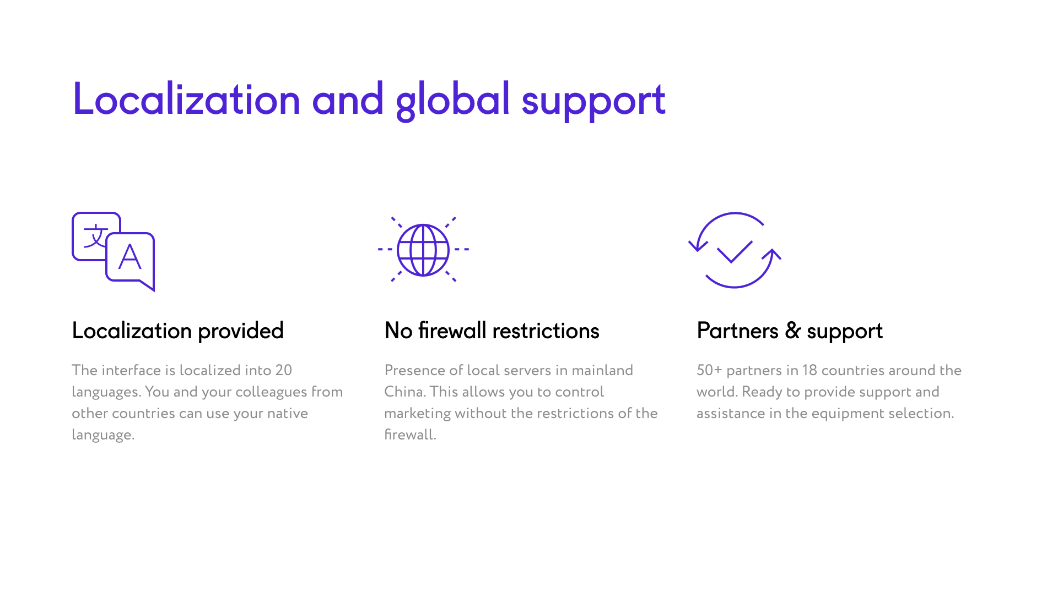
Prestigio-Addreality: Key benefits
Benefits for decision makers, responsible for BUSINESS part (commercial directors, marketing, etc.)
Benefits for decision makers, responsible for TECHNICAL part (engineers, team leads, projects manager etc.)
Advertisement monetization
Inbuilt device status and content monitoring system
Personalized communication
Remote control of devices
Profit from direct sales module
Integration with LDAP* and open API** for integration with internal systems
Audience portrait
Triggers on Audience recognition
Templates
Visual content editor simple for Marketing manager
Network management, flexible traffic adjustment, schedules , Remote updates
Digital ads 33% more effective than printed ones
GDPR compliant
*- Lightweight Directory Access Protocol
**- Application Programming Interface

Slide 11
Prestigio Addreality Benefits
Deep dive
PART 1.
Prestigio Addreality benefits for business

Slide 12
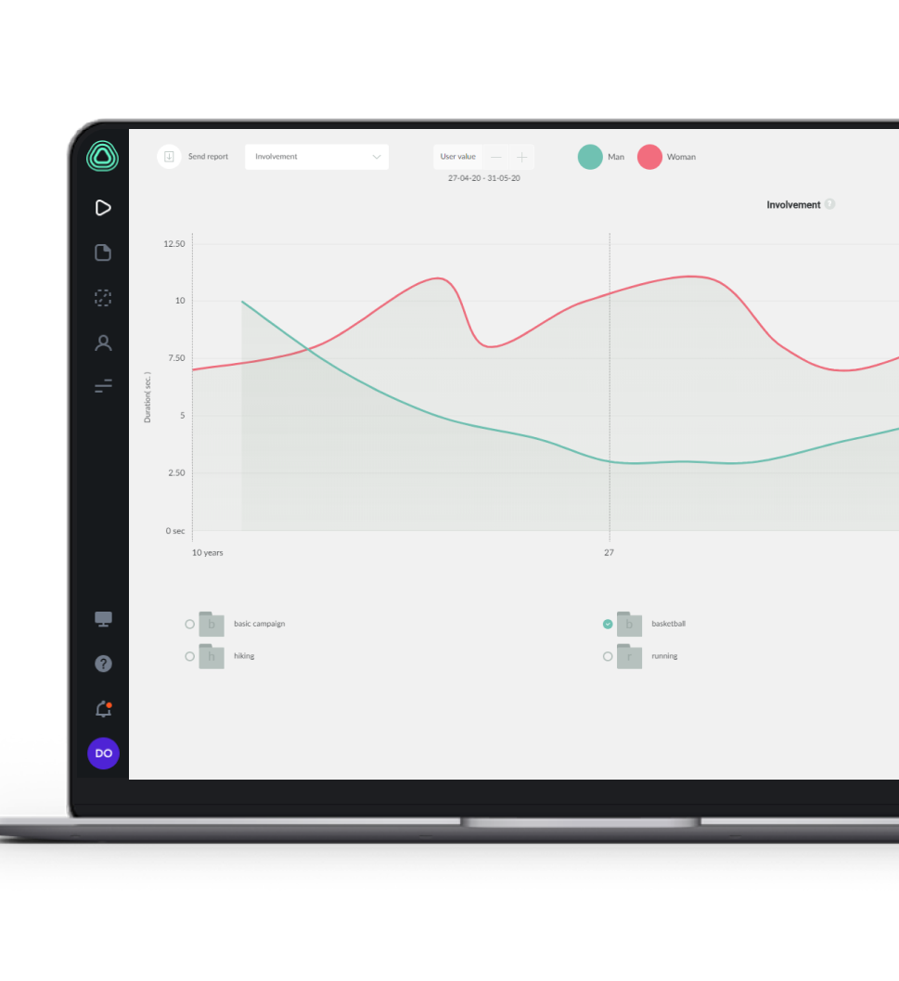
Advertisement monetization
Benefit from the platform that can create multiple revenue streams. Prestigio Addreality offers way to reach users and maximize an advertisement potential.

Slide 13
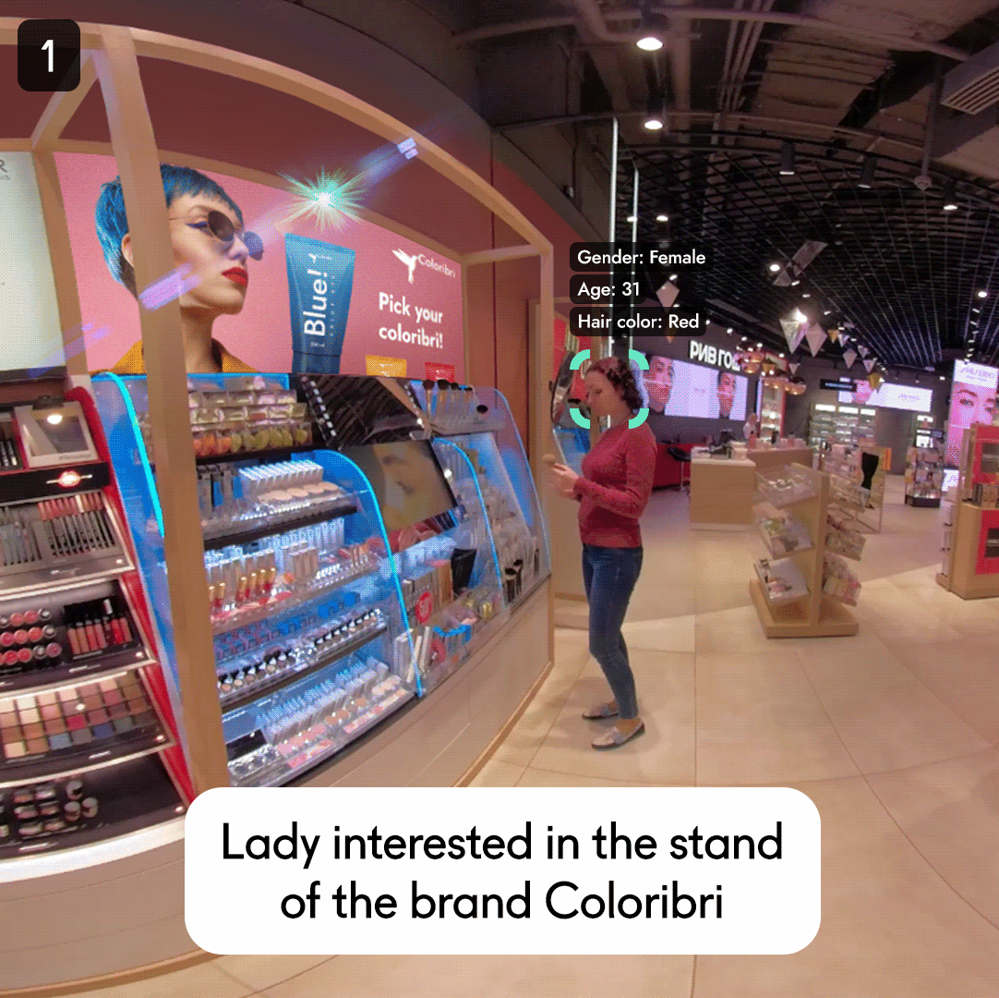
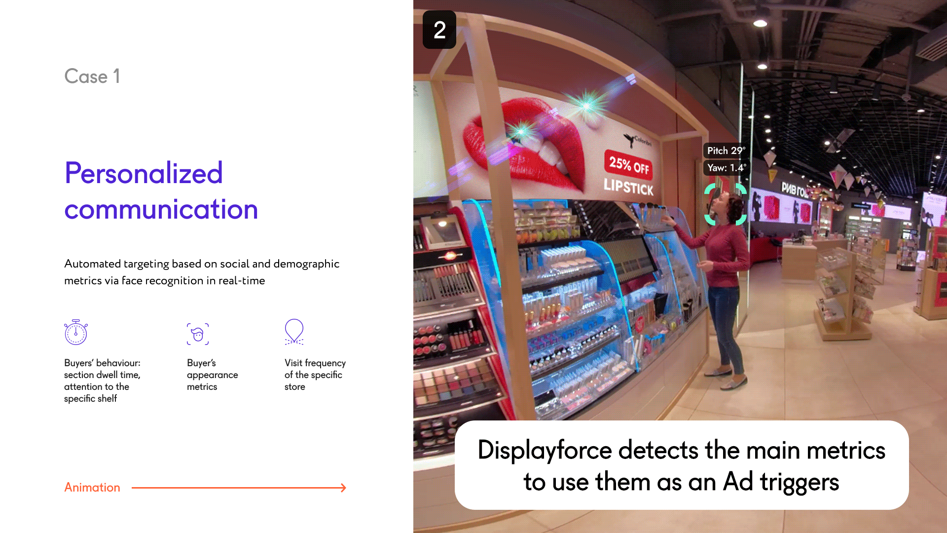
Personalized
Communication
Automated targeting based on social and demographic metrics via face recognition in real-time.

Slide 14
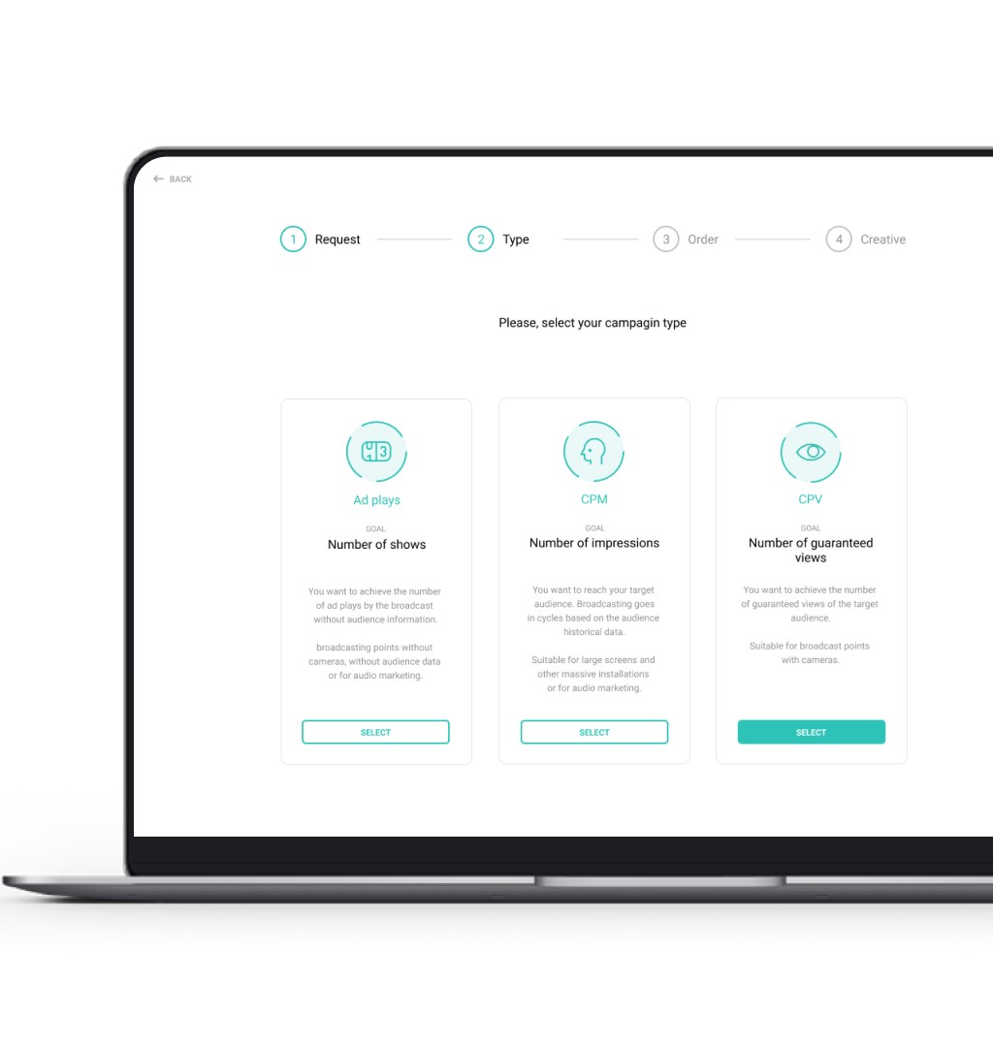
Direct sales module
Over 90% of brands buy an audience.
Now you can combine sales by the number of broadcast with new models: CPM* model (for 1000 OTS**) and CPV*** model (for confirmed contacts with the target audience based on computer vision technology)
*CPM – cost per mille
**OTS – opportunity to see
***CPV – cost per view

Slide 15
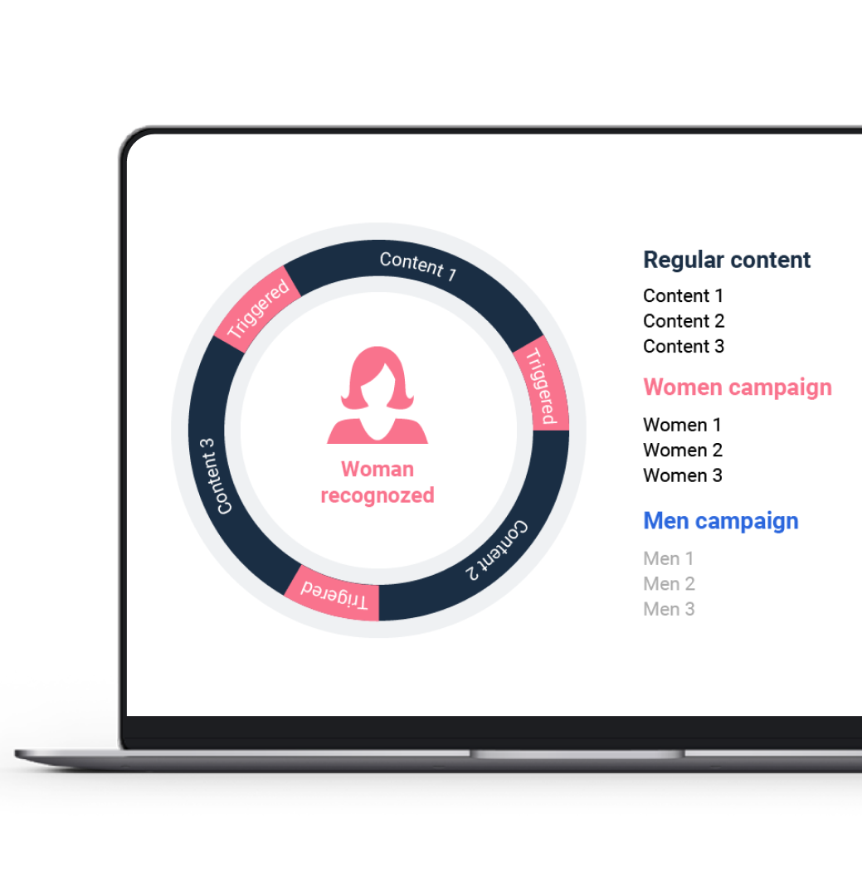
Audience Recognition
We collect and enrich customer data with the help of own GDPR/CPAA compliant Face Recognition neuro network. It gives us deeper accuracy in audience recognition and targeting ads messages.
Specific information could be triggered and delivered for each type of visitors

Slide 16
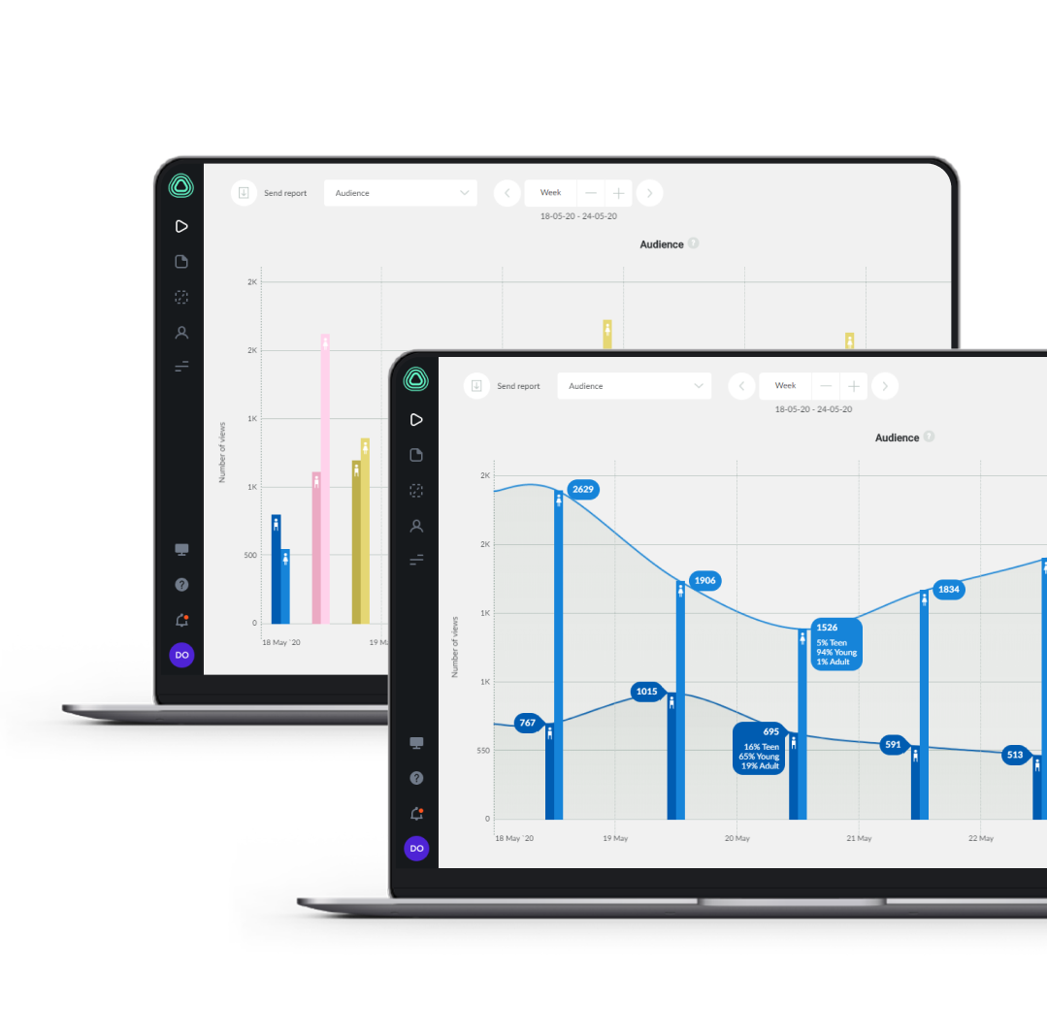
Audience Portrait
Information about audience demographics filters by devices. Gender classification with up to 90% accuracy. Age classification: 3 age groups (child, youth, adult), absolute age (+/- 5 years).

Slide 17
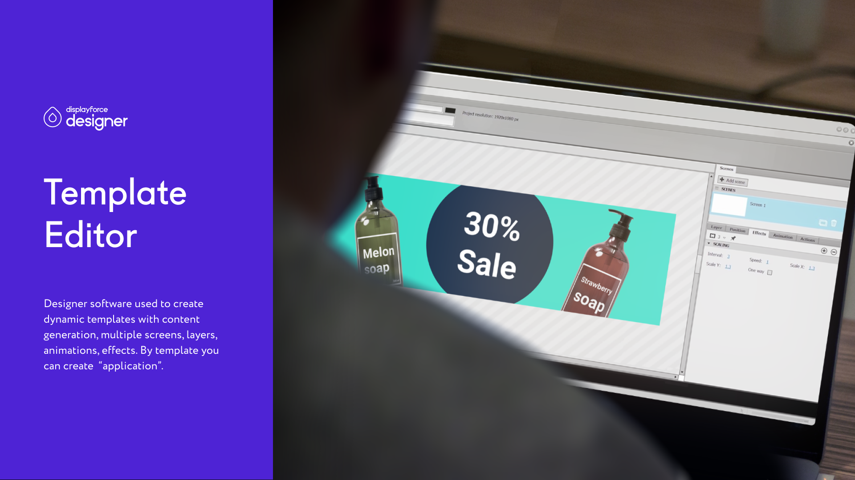
Content editor
Designer software used to create dynamic templates with content generation, multiple screens, layers, animations, effects.

Slide 18
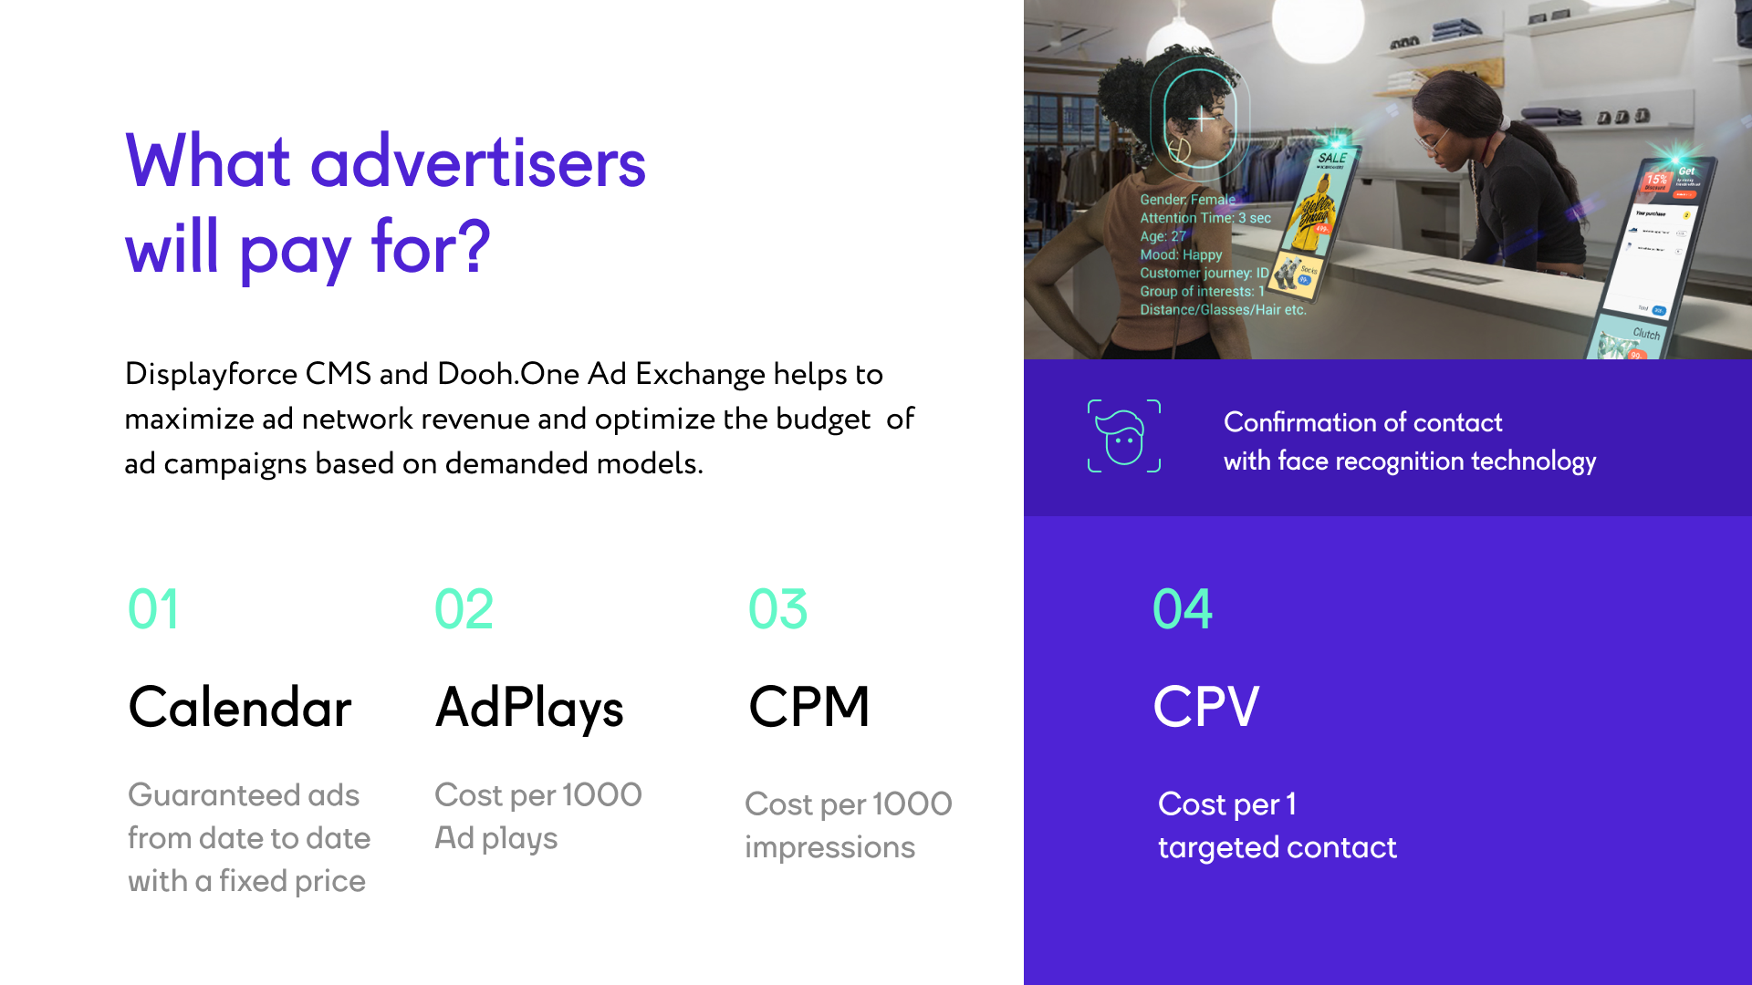
Effectiveness of digital adds
Digital advertisement is 33% more effective than printed ones. It catch attention, enhance involvement and overall impression from the advertisement message.

Slide 19
PART 2.
Prestigio Addreality benefits for technicians

Slide 20
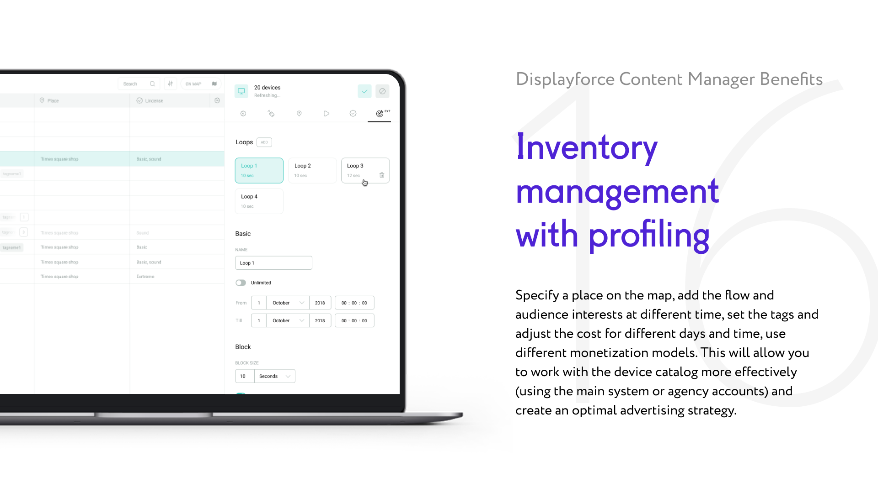
Inbuilt device status and content
monitoring system
Get online statuses of all connected devices. Be aware if the content is really run.
No need to install 3rd party monitoring system, get all information and notifications from one place.
Get full statistics regarding work and usage of the devices and content.

Slide 21
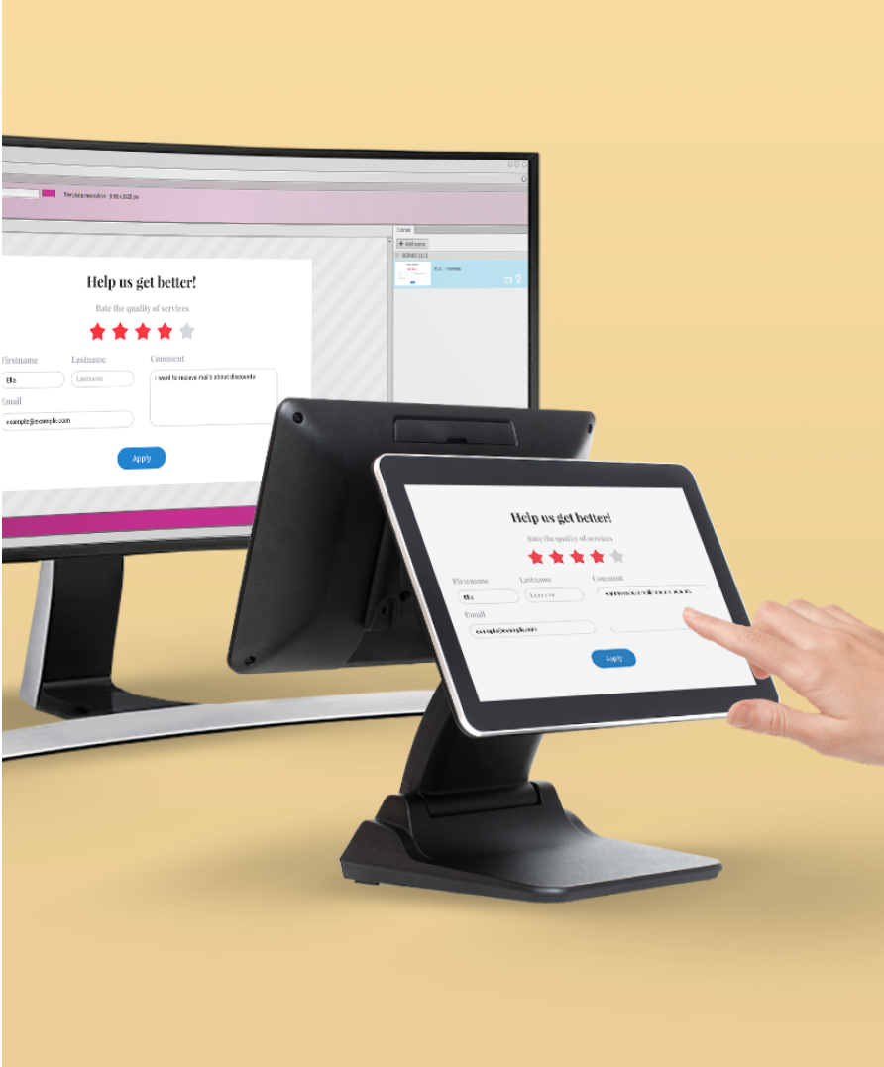
Remote control of devices
Control different types of devices from one place: send commands manually or by schedule.
You have presets of commands for device, software player, content, project.
Group devices to control them even more easily.

Slide 22
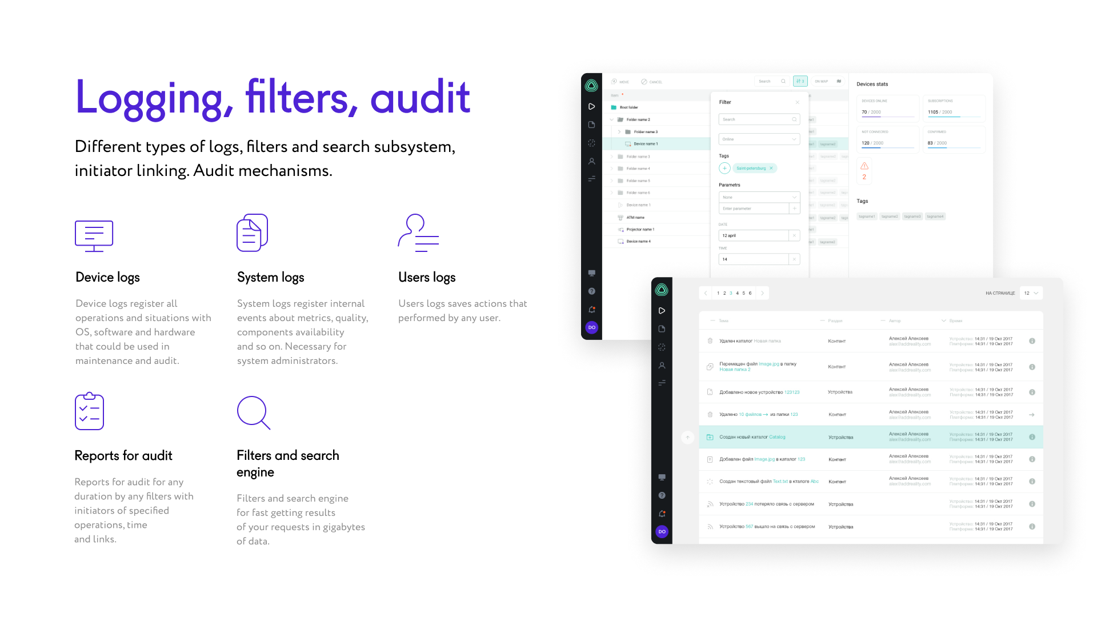
Integration with LDAP and
open API for integration with
internal systems
You can use inbuilt group access policies or LDAP for easy integration with your Active Directory. Open API is available to integrate with internal Databases and services for automation and more functionality.

Slide 23
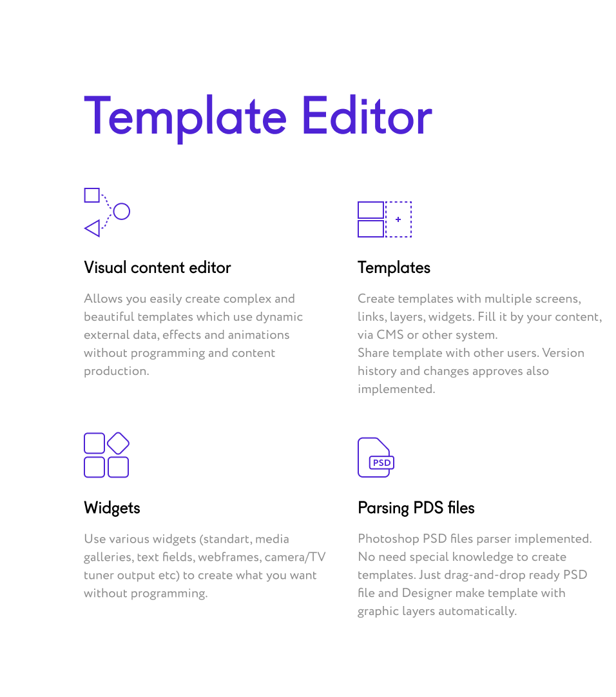
Templates
Built-in interactive templates allow you to create rich and focusing campaigns for any need.

Slide 24
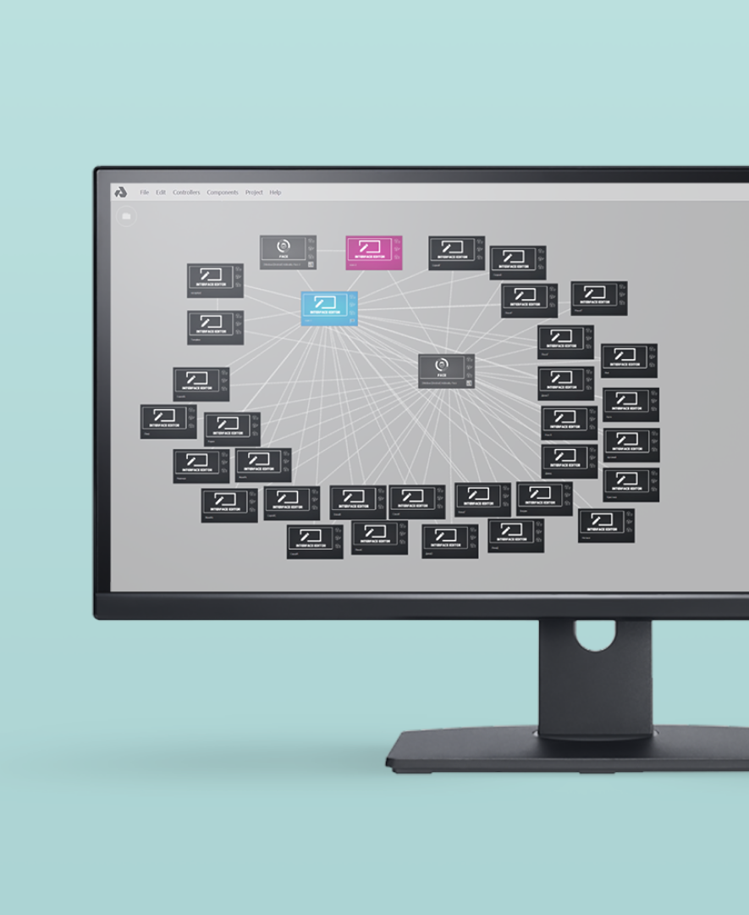
Network management
Add, edit and remove platform user roles, including the ability to turn on/off access to individual platform features.

Slide 25
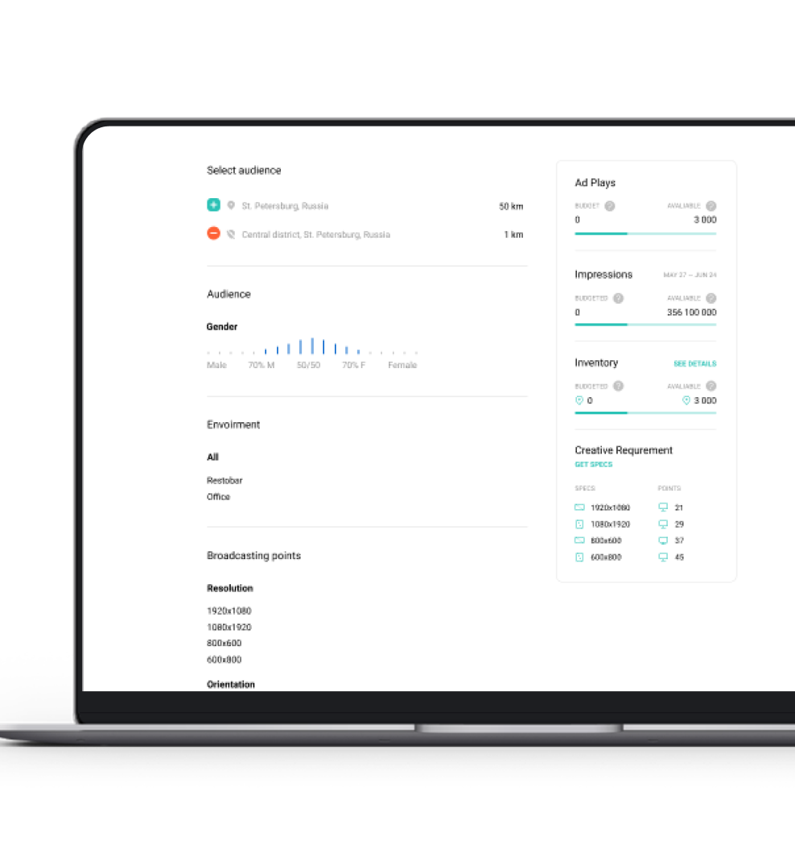
GDPR compliant
We collect and enrich data with the help of own depersonalized Face Recognition neuro network, that ensures full compliance with the GDPR requirements.

Slide 26
Part 3. Proven Success Stories

Slide 27
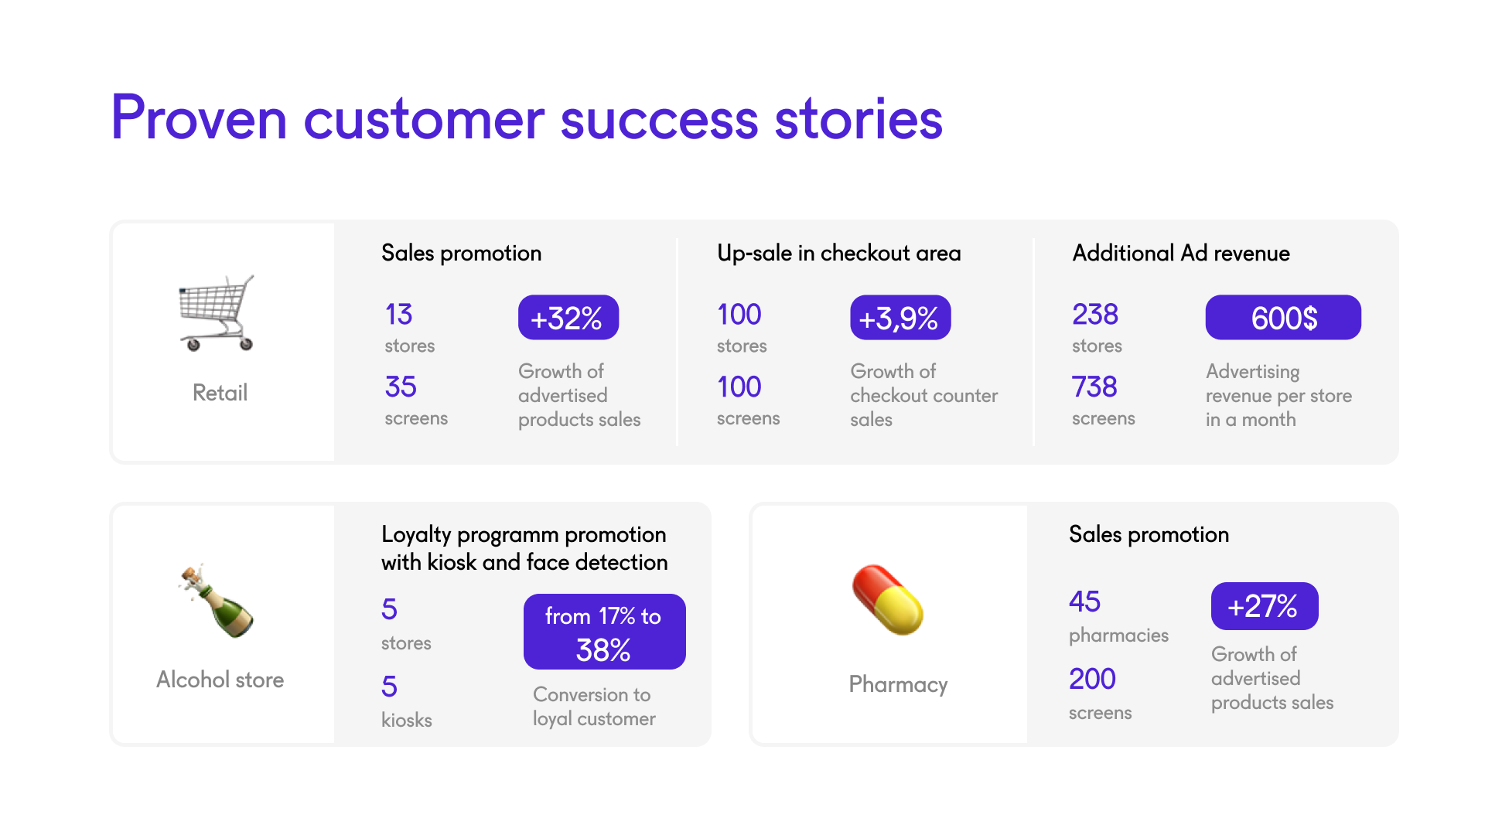

Slide 28
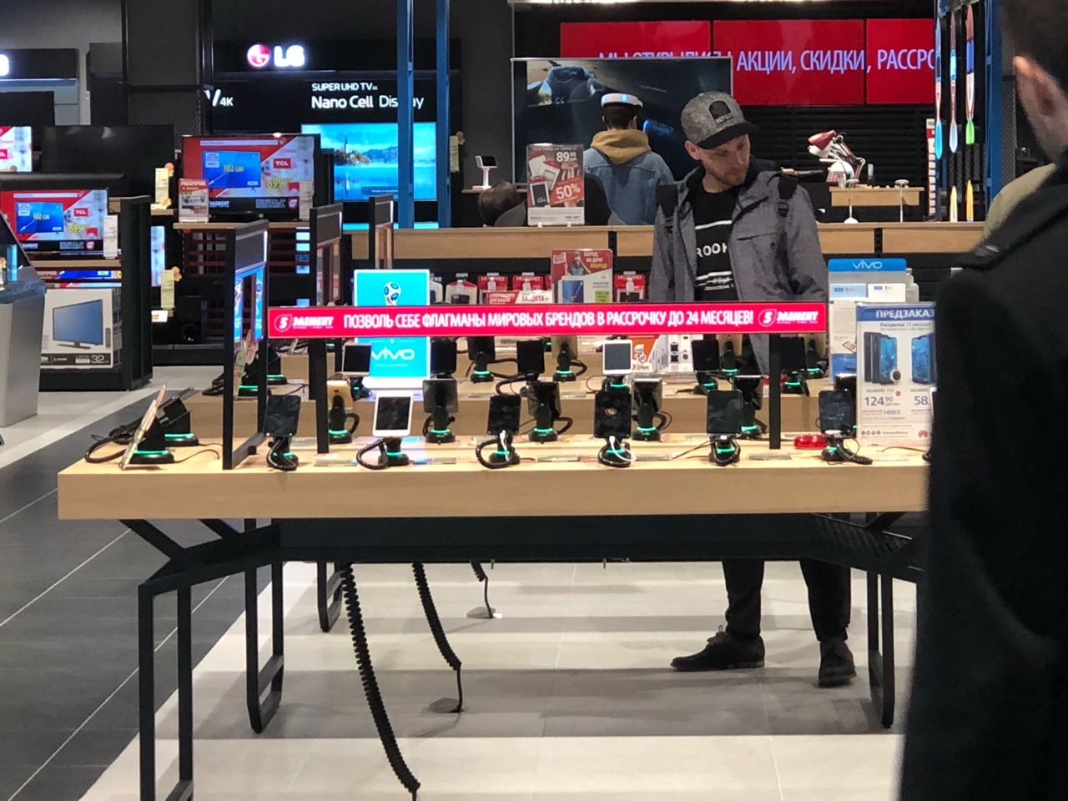
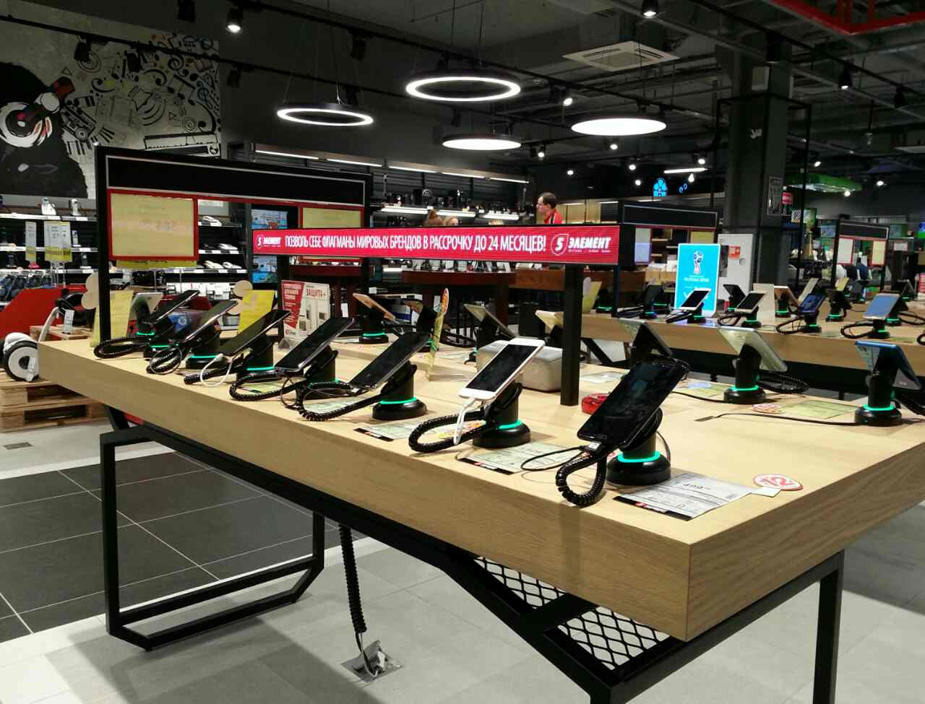
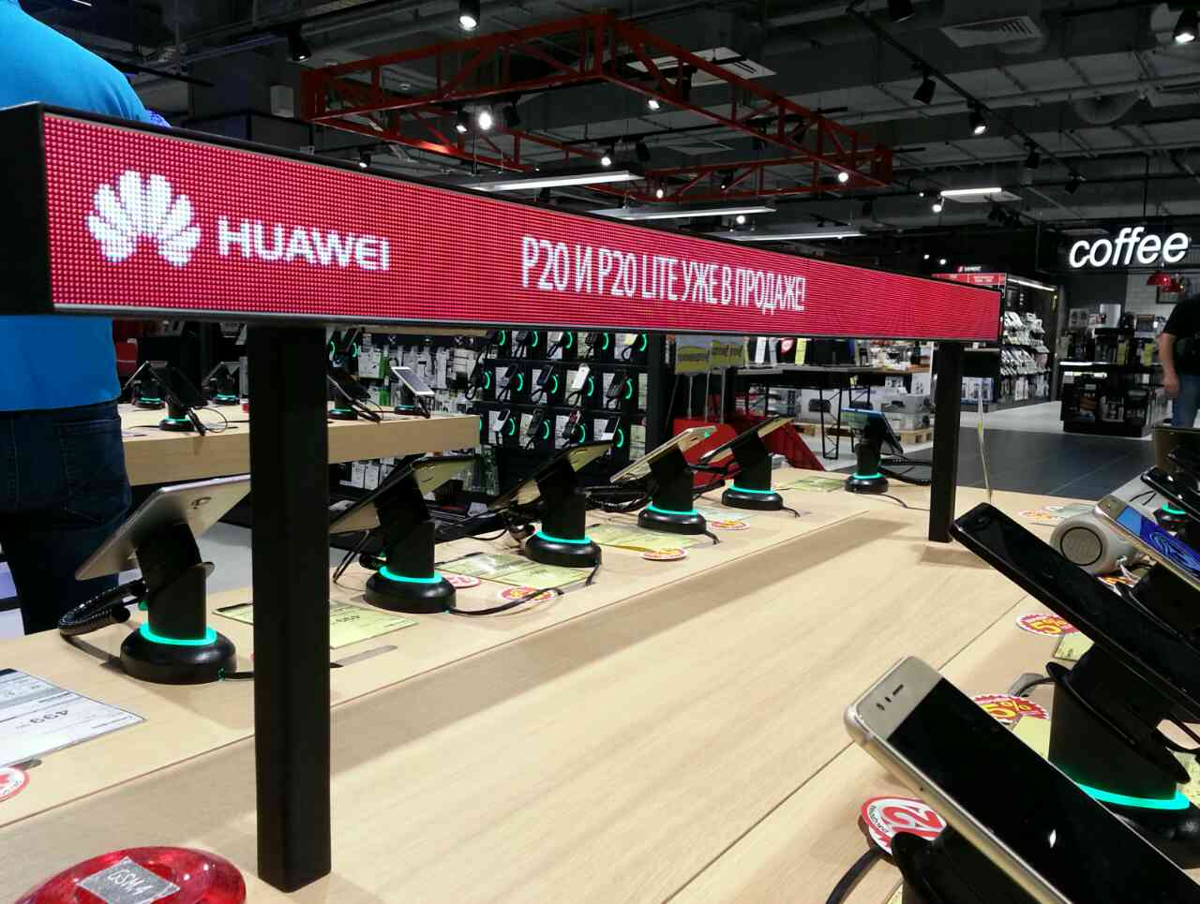
Electronics Retail LED shelves 5th Element project
Electronics Store Chain
5th Element, key retailer in Belarus, Minsk.
Project includes integration of LED shelf solution. Content managed by Prestigio AddReality IDS software.
Attracting the attention of the customers which just walking near the shop.
Increasing of the potential customers (inside the shop) up to 30%
Increasing sales from current shelf up to 23%

Slide 29
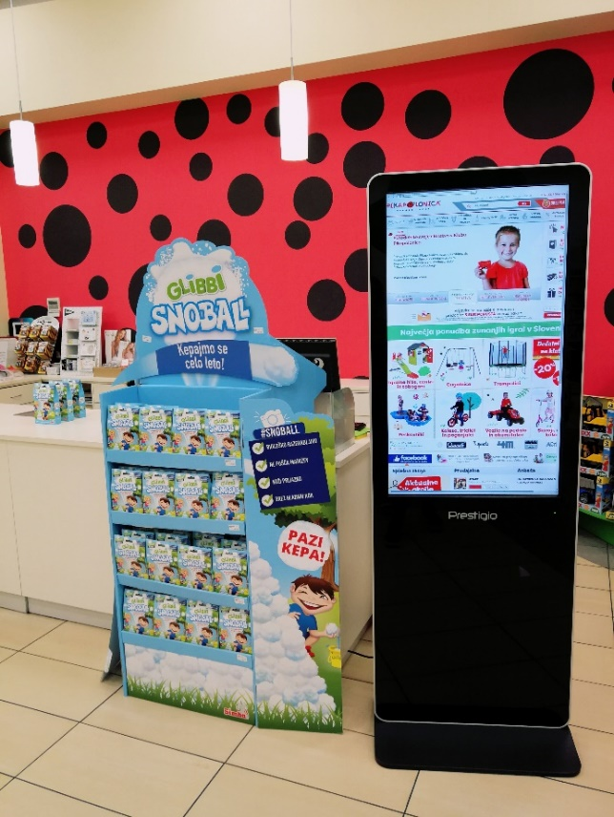
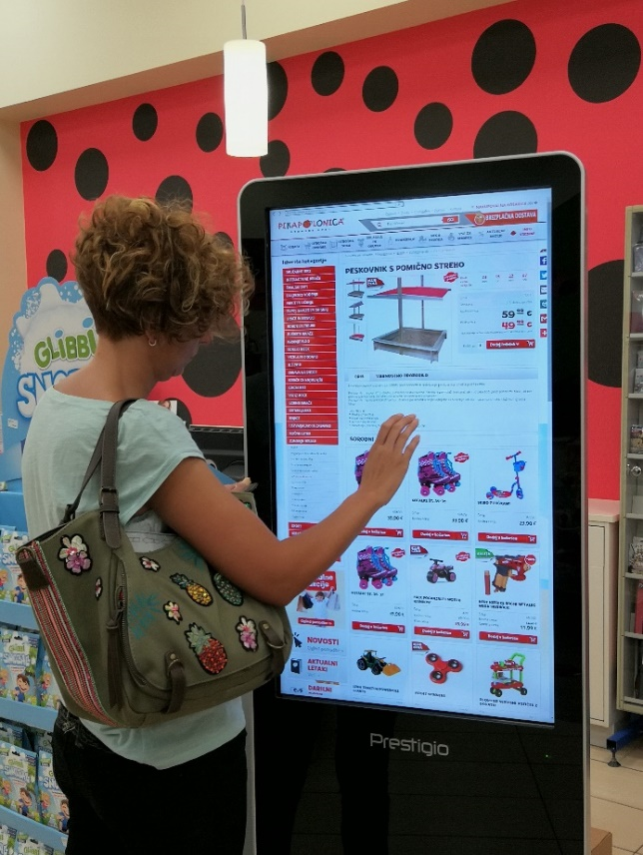
Slovenia
IDS solution: 43” Totem
Client: Pikapoka d.o.o. (retail, children products)
Business need: Display of marketing promotions and new product offerings, so that to raise customers’ activity and increase sales
Sales channel: Local sales team was the main contact for the client and it closed the deal. However, totem was sold through partner Teksel, as they are responsible for after-sales support.
Decision maker: Director

Slide 30
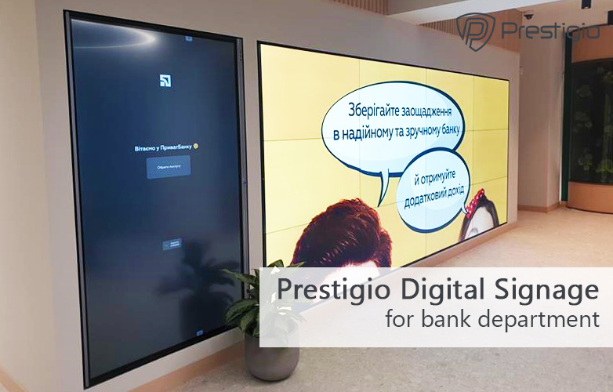
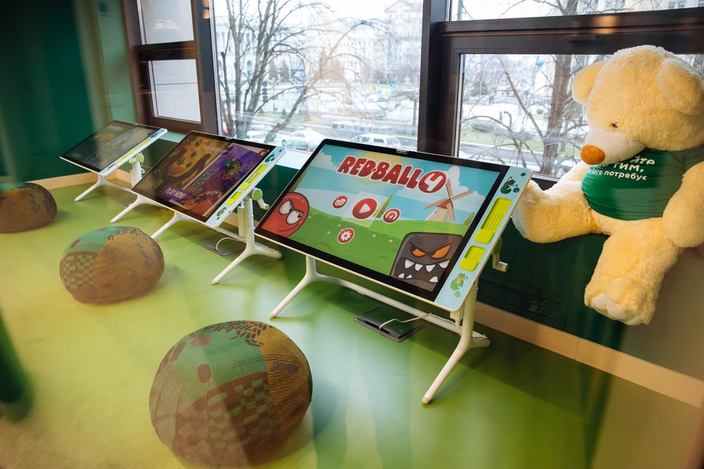
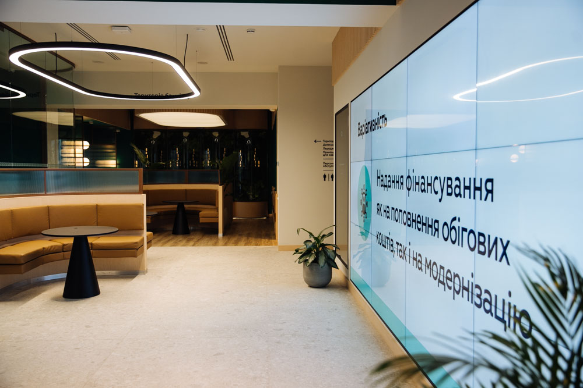
Ukraine
Solution: MB 43’’, 86’’, LED Poster, Prestigio Addreality Software on premise
Client: Privat Bank, Kiev
Business need: create innovative environment and engaging customer experience in “Bank department of the future”
Sales channel: deal was agreed directly, but sale go via integrator
Decision maker: Marketing director

Slide 31
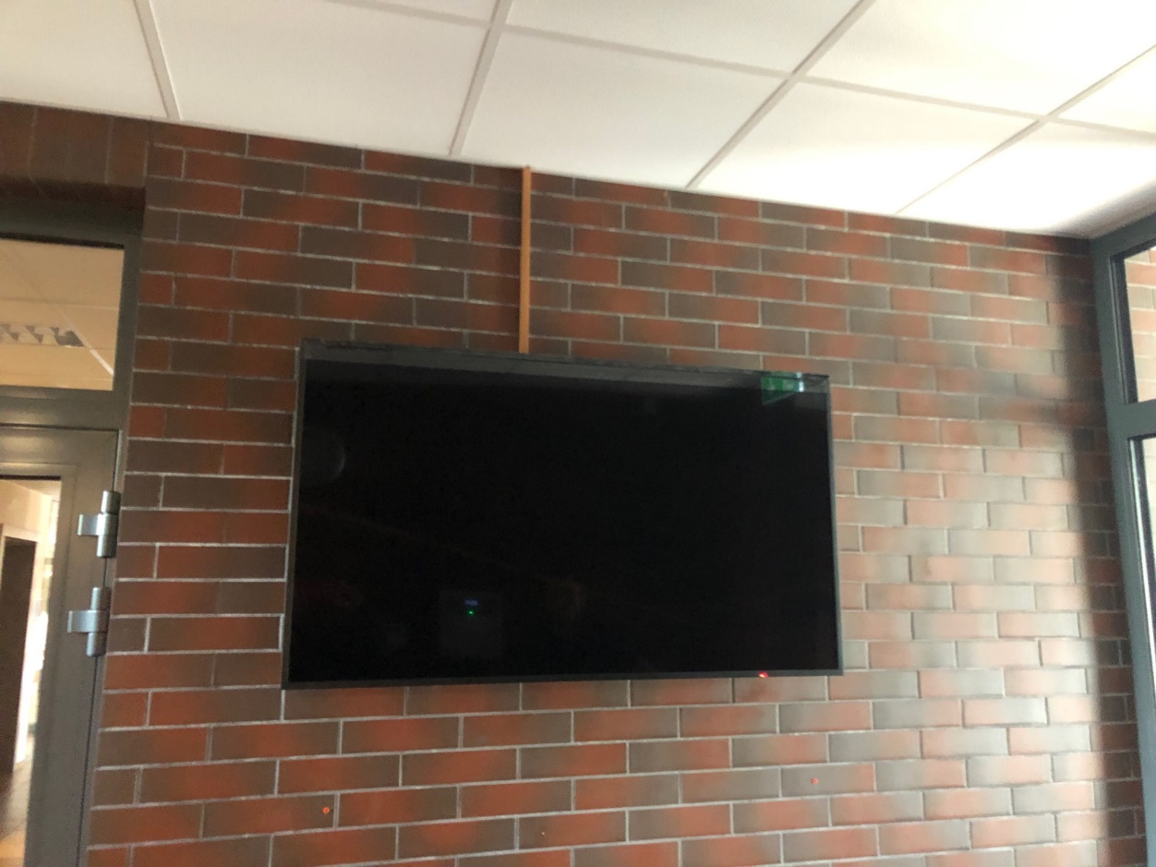
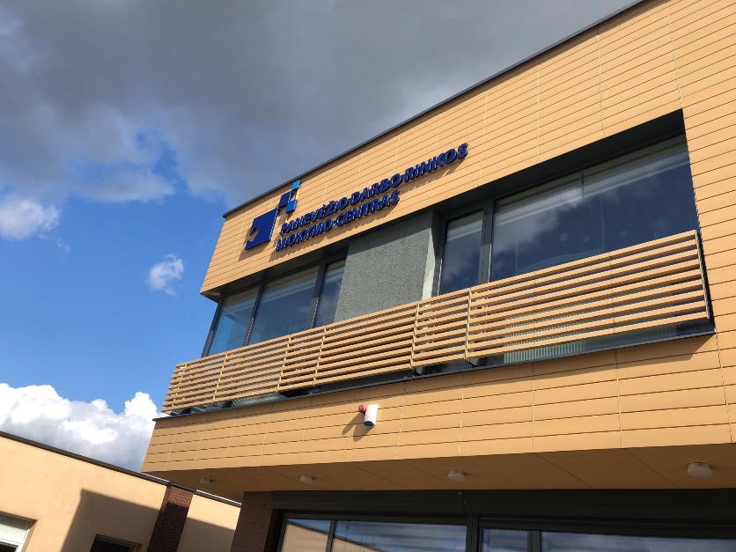
Lithuania
IDS solution: 55” LCD wall mount PDSIK55WNN0L+ Multicenter PAB4411+Prestigio Addreality (Signage license)
Client: State educational center
Business need: demonstration of actual info, courses timetable at the entrance area
Sales channel: via integrator
Decision maker: IT manager
Client’s feedback: quite positive feedback received from the client

Slide 32



Sales of Prestigio Addreality Software
Benefits for Business Development Manager
Opportunity for cross-sale
Recurring payments for licenses
ensure steady sales
Training materials available
Support from the Central team
Available client and partner's base
Easy start with free trial version
Easy repeated sales because of licenses prolongation

Slide 33
Thank you!

